Slide 1
The Equatorial Pattern from Muscle

Slide 2
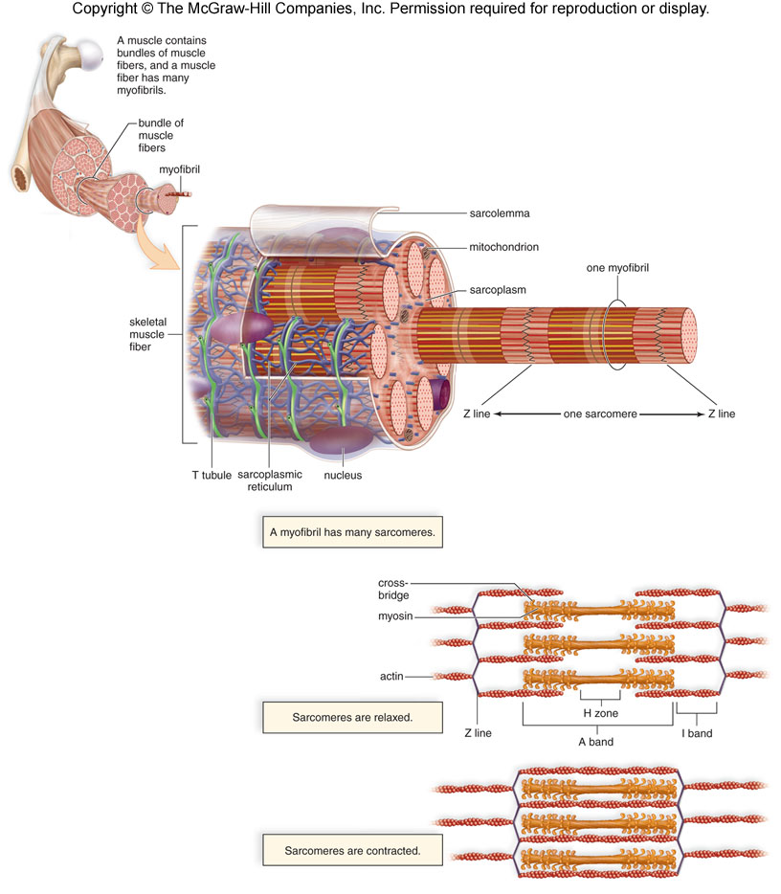
Myofibrils and Sarcomeres
A myofibril consists of many 2-3 micron long sarcomeres laid end to end
In the light microscope, sarcomeres show a banding pattern (striations)
A-band, I band, Z-line, and M-line, H-zone
Underlying structure can be seen only at electron microscope level

Slide 3
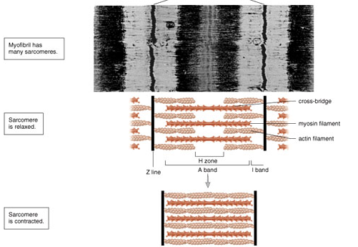
Sarcomeres
Sarcomere consists of actin containing thin filaments
Myosin containing thick filaments
I band contains only thin filaments
H-zone only thick
A-band both thick and thin
Projections on the thick filament (crossbridges) interact with the thin filament and cause sarcomeres to shorten
11-9

Slide 4
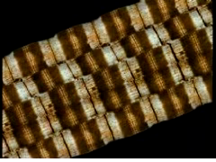
“Sliding Filaments”

Slide 5
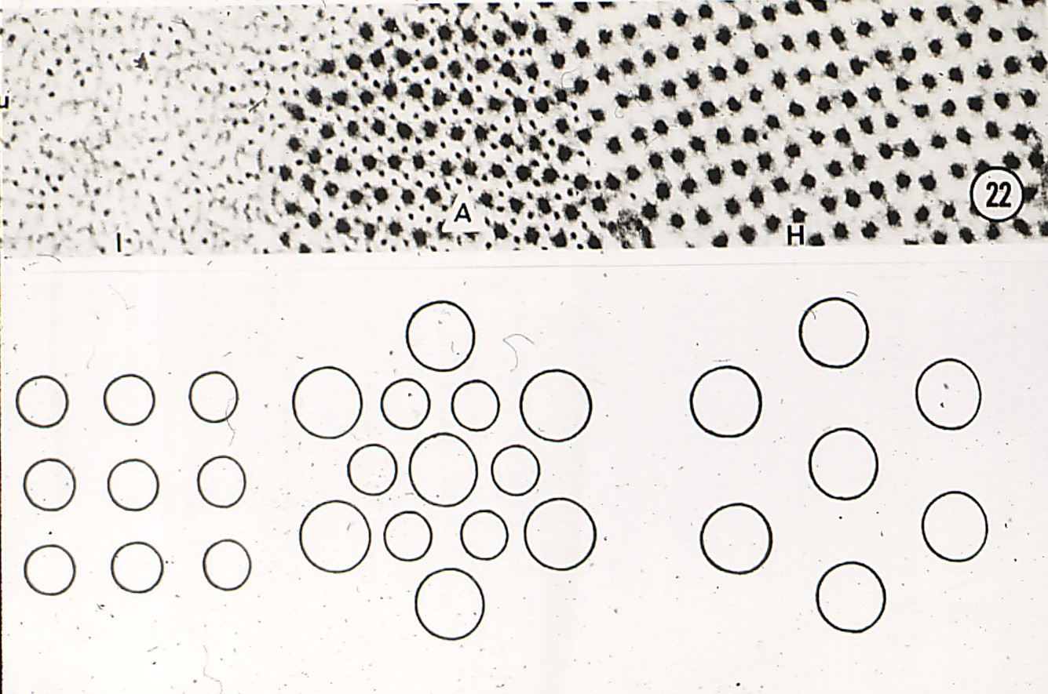
Cross-sections of a sarcomere showing 2-D crystalline structure
Thin filaments near Z band
Thick and thin filaments overlapping in A-band
Thick filaments Only in H-zone

Slide 6
Hexagonal Lattice
u
y
→
b
a
→
x
a
→
→
b

Slide 7
Ewald Sphere
k a*
2 θ
1
O
λ
h a*
For every lattice in real space there is a corresponding lattice in “recripocal” i.e. diffraction space. Distances between lattice points are proportional to 1/lattice dimensions in real space. The origin of the reciprocal lattice is at O. Lattice points (corresponding to diffraction spots one can observe) are indexed by Miller indices h and k

Slide 8

End on view of hexagonal reciprocal lattice
This was taken by shining the X-ray beam down the axis of a muscle myofibril.(one crystallite)
Not the way we normally do it.

Slide 9
Fiber Cross-section
Diffraction
X-rays
Myofibrils are at random orientations around the long axis of the muscle fiber
Complete Statistical rotation:
1,0 = 1,0 = 0,1 = 0,-1
1,1 = 1,1=1,1 = 1,-1

Slide 10

Equatorial pattern from insect muscle
We are looking at projection of hexagonal lattice onto a plane. Insect muscle is highly ordered so you get lots of sharp spots along the equator.
Note that they vary in intensity
Equator

Slide 11
Experimental arrangement of the BioCAT undulator beam line for X-ray diffraction
muscle
bath
CCD
detector
mirror
X-rays
evacuated flight tube
(X-ray reflections)
undulator X-ray source
(electrons)
inverted
microscope
X-rays
diff.
actin
myosin
1,1
d
A
θ
C
θ
B
θ
1,0
AB=BC=d₁₀ sin θ
D
X-rays
2θ
F
2sin ϑ = nλ/d
2sin ϑ = D/(D²+F²)^{1/2}
d = (nλ(D²+F²)^{1/2}/D)/2
inter-thick filament spacing = d*(2/√3)

Slide 12
Calculating d₁₀
Braggs Law
nλ = 2dsinθ
θ is the Bragg angle where 2 is the angle between the diffracted and incident beam
At small angles
Θ = D/2L so that
nλ = 2dD/2L
Or
d=nλL/D
So d, the spacing between the diffracting planes is inversely proportional to D, the distance from the origin of the diffraction pattern to a diffraction spot

Slide 13
Hexagonal pattern selection rule
The distances from the center of the pattern to each of the outer reflections (S_{h,k}) are related to the distance from the center to the first strong 1,0 reflection, S₁₀, by S_{h,k} = S₁₀√(h² + k² + hk) where h and k are the Miller indices of each reflection. Notice that several combinations of h and k values will give rise to the same S_{h,k} meaning that X-ray reflections will superimpose.

Slide 14
Estimating lattice disorder parameters from peak widths
The width of the Gaussian representing a given diffraction peak σ_{h,k} can be expressed as
σ_{h,k} = √(σ_{c}²+ σ_{d}²S_{hk} + σ_{s}²S_{hk}²) where S_{hk} = √(h² + k² + hk). σ_{c} is the known width of the X-ray beam, σ_{d} is related to the amount of heterogeneity in inter-filament spacing among the myofibrils, and σ_{s} is related to the amount of paracrystalline (liquid-like) disorder of the myofilaments in the hexagonal lattice.
These are all interesting physiological paramaters

Slide 15
Equatorial Intensities
If crossbridges move away from the thick filament backbone towards the thin filament
Mass leaves the 1,0 plane and joins 2,0
I_{2,0}/I_{1,0} goes up
UseI_{2,0}/I_{1,0} as a measure of degree of association crossbridges with thin filament
In vertebrate muscle use I_{1,1}/I_{1,0} instead

